Slide 1
{Web Development Tools and framework}
Remy Mumoh.
@remymumoh

Slide 2
Today’s Talk
Brief History of Web Development Stages of Web Development
Concept Development
Prototyping
Development
Testing
Launch
Maintenance
Tools & Frameworks
Next Generation Development (exciting stuff!)
Q&A

Slide 3
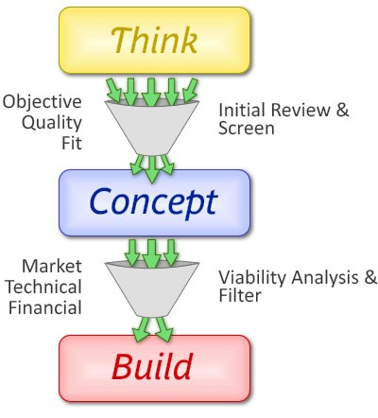
Web Development Stages 1 – Concept Development
Lets discuss:
Who is this website for? (the types of users)
Why am I making it? (what is the problem?)
What is the most important thing visitors should do on your website.
Sketch (draw) your website outline.

Slide 4
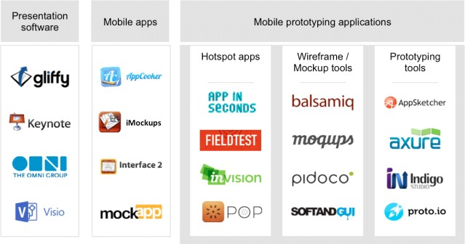
Web Development Stages 2 – Prototype Development
A “broken” version of your website:
Links work, but don’t lead to any content.
“User Journey” is complete:
“As a I want to “
Quick to change and move things around.

Slide 5

Web Development Stages 3-Development
Ideally, your requirements are complete
Work at an iterative pace:
Develop at the lowest possible work unit
Use the tool that suits you, and makes you the most productive:
Text Editor
IDE
Terminal
GUI

Slide 6





Web Development Stages 4 -­‐ Testing
If you don’t test; prepare to fail. Types of testing:
Functional Test (does the feature work?)
User acceptance test (is it what the user wants?)
Unit test (is the code stable?)
Coverage tests (are all code paths executing?)

Slide 7



Web Development Stages 5 -­‐ Deployment
Deployment Process Should Be:
Documented
Repeatable
Predictable
Rehearsed
Tools help!

Slide 8


Web Development Stages 6 -­‐ Maintenance
Small effort, big rewards
Enable maintenance by tracking:
Successful requests
Failed requested
Repeated failed requests
Key function execution
Infrastructure

Slide 9
Tools & Frameworks
USE THESE TO JUMPSTART YOUR DEVELOPMENT

Slide 10
































Tools and Framework

Slide 11





Tools and Framework
Categories of Tools & Frameworks:
Server Side Development

Slide 12






Categories of Tools & Frameworks Frontend Development
Tools and Framework

Slide 13













Categories of Tools & Frameworks Platforms
Tools and Framework

Slide 14



Categories of Tools & Frameworks Development Helpers

Slide 15
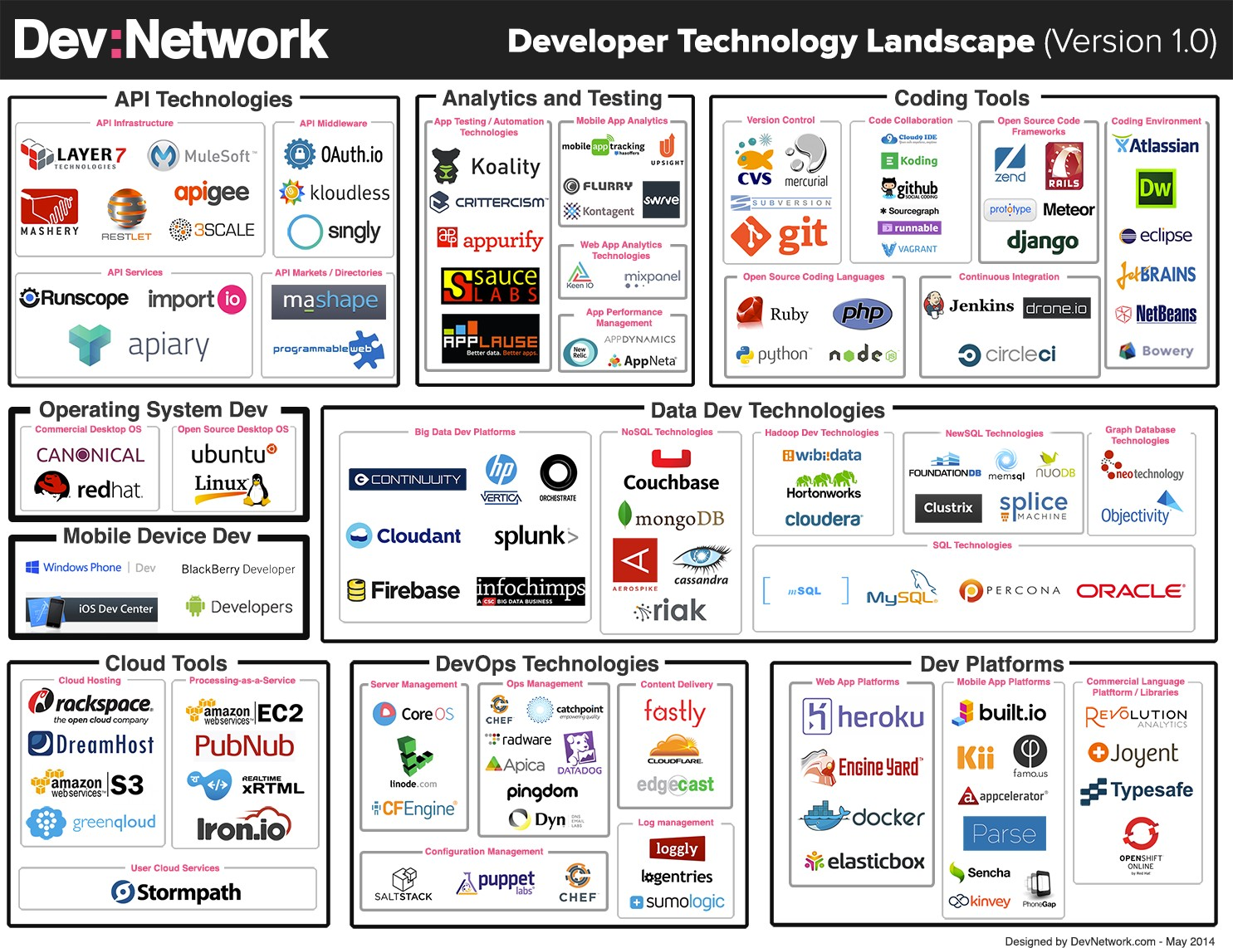

Slide 16
A quick note about workflows
A good development workflow:
Helps you get started.
Maintains your dependencies.
Enforces best practices.
Prepares your tools.
Fights regressions.
Eases the release process.

Slide 17
Classic Web Application Architecture
BASIC BUILDING BLOCKS FOR MOST WEB APPLICATIONS

Slide 18
The old (and current) way
View (code to render
HTML)
DATABASE (the
models)
Server Code (controllers)
Client Side Javascript (jquery components)
HTML Templates; CSS; layouts

Slide 19
Modern Web Application Architecture
ADVANCED APPLICATIONS – FOR ADVANCED DEVICES

Slide 20
Modern Applications (Simplified)
Services
(API, Authentication, Caching, Serialization)
Models (database, document)
View Layer (code to render HTML)
Business Logic (controllers, routers)
Presentation (HTML, CSS,
Responsive)
Local Storage (HTML5)
Models (client side models)

Slide 21
Front-end
Remy Mumoh
2019

Slide 22




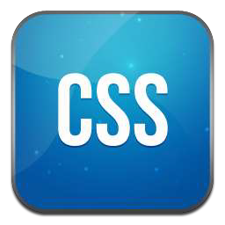

Front-end

Slide 23



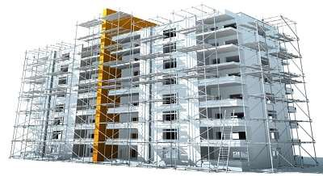
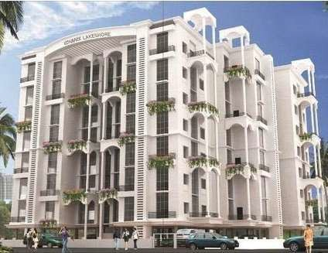

Three layers of web design:
Structure
HTML markup
Style
CSS
Behavior
JavaScript

Slide 24
HTML =
Hyper Text Markup Language

Slide 25
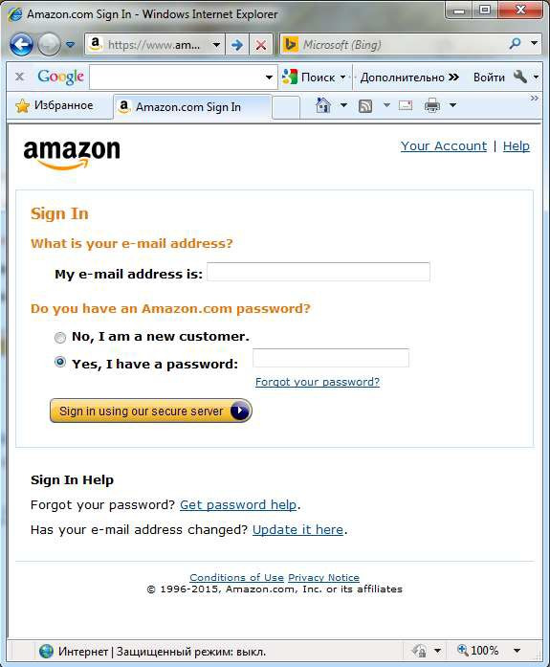

Do you imagine how this page would look like without HTML?

Slide 26
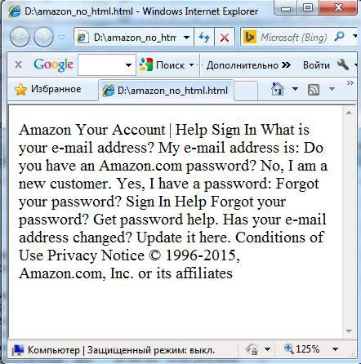

Looks ugly… Doesn’t it?

Slide 27
No HTML?
Without any markup to give your page content structure, the browser renders unformatted and unstyled text

Slide 28

HTML tags give
structure
and
meaning
to your content.

Slide 29
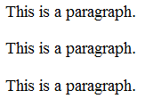
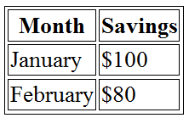
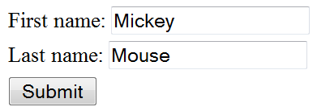

HTML Tags
<p></p> - to organize text into paragraphs
<table></table> - to display table
<form></form> - to define
form for user input
<img></img> - to add image

Slide 30

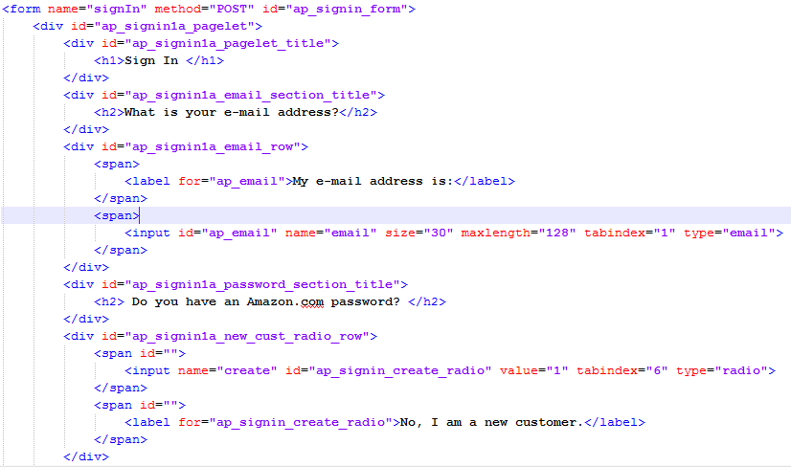
Lets add HTML tags to our page...
How will it look now?

Slide 31
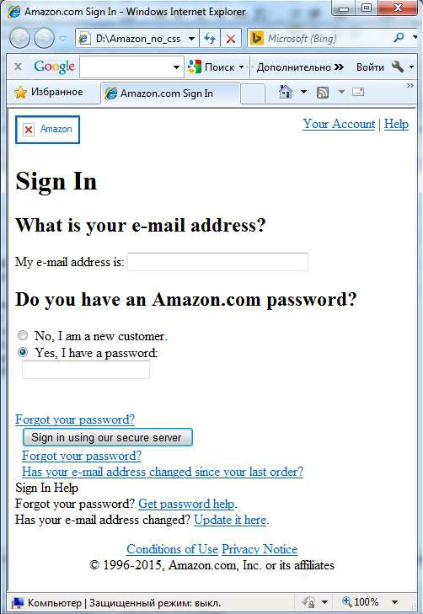

Looks better… But still not good…

Slide 32

HTML
Once page content is marked up with HTML tags, the browser applies default styles to the tags.
So now page is readable and have a clear hierarchy.

Slide 33
But what should we do to
make the page look nice?
The answer is
use CSS!

Slide 34
CSS =
Cascading Style Sheet

Slide 35

CSS
Set of rules defining how an html element will be “presented” in the browser.

Slide 36

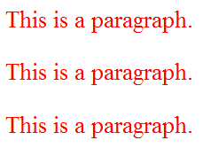
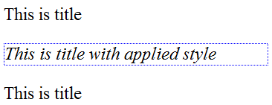
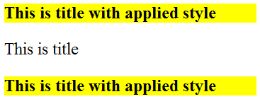
CSS Rules
p {
color: red;
}
#title {
font-style: italic; border: 1px dotted blue;
}
.title {
font-weight: bold; background: yellow;
}

Slide 37
Some things you can change
with CSS
colors
font
font size
backgrounds
spacing
sizes
borders
positions (layout)

Slide 38
Some things you can’t change with CSS
content
markup

Slide 39

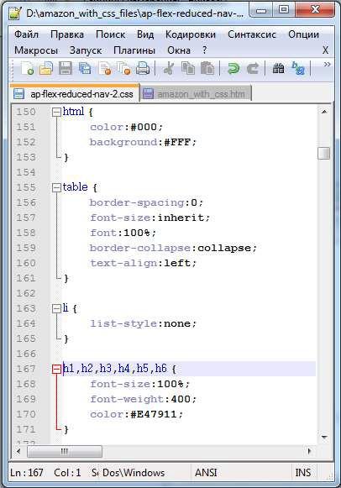
So now it’s time for styling!!!
Lets add some css rules to our example page.

Slide 40

How will it look now???

Slide 41
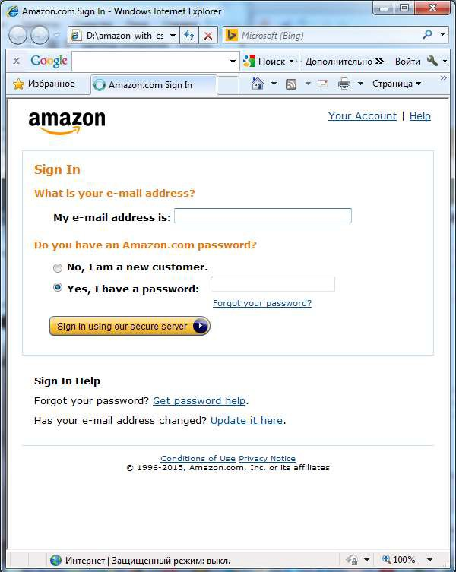

Looks
perfect!

Slide 42
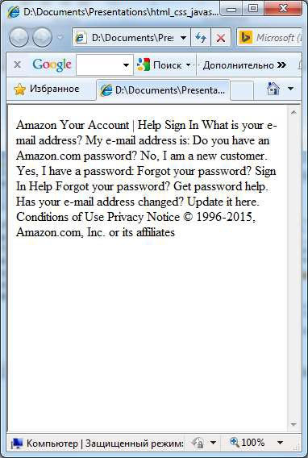
Text
+ HTML
+ CSS
= Web Page

Slide 43
Now time for actions!
JavaScript

Slide 44

JavaScript ≠Java
JavaScript was not developed at Sun Microsystems, the
home of Java.
JavaScript was developed at Netscape in 1995.
It was originally called LiveScript, but that name wasn't
confusing enough. ☹
Java was the buzzword in the days when LiveScript was created, so LiveScript was renamed into JavaScript in the hope of catching the media’s interest.
But from confusion came misunderstanding…

Slide 45

JavaScript ≠ Java
JavaScript is NOT a Java
It is NOT a light version of
Java
It was NOT based on Java
It does NOT matter if you know Java

Slide 46


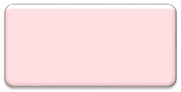
JavaScript
Classic JavaScript is a client-side language used to add interactivity to your web-pages
Web Browser
Web Page
JavaScript

Slide 47
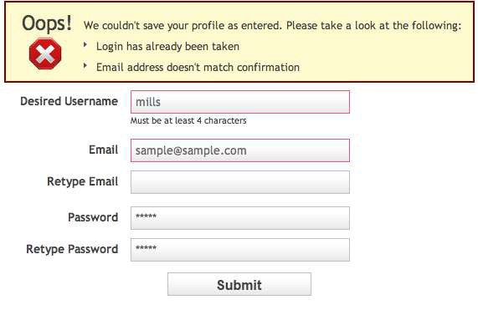
What we can do with JavaScript?
Validate values entered in the form fields

Slide 48
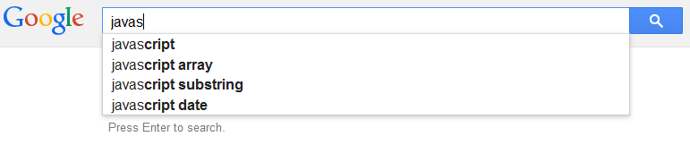
What we can do with JavaScript?
A search box can give you suggested results while you type, based on what you’ve entered

Slide 49

What we can do with JavaScript?
Load information automatically when it's needed

Slide 50

What we can do with JavaScript?
Create photo slideshow and control how long it takes to move from one image to the next and with what animation effect

Slide 51
What we can do with
JavaScript?
And much much more…

Slide 52

JavaScript
At the beginning JavaScript was
designed to manipulate web pages.
And it does that very well!
But nowadays its usage is much much wider: you can use it outside of web pages and the browser

